Slide 1

M! e-diary
EXPLORE YOUR THOUGHTS
PROJECT GUIDE:
DR. K. DEVI PRIYA
Notes:
NOTE:
To change the image on this slide, select the picture and delete it. Then click the Pictures icon in the placeholder to insert your own image.

Slide 2
MISSION STATEMENT
Diary-keeping is a boon for many people. If one is a busy businessman, one may not remember everything, so in that case, diary making is a habit with immense benefits.
Some people intend to write things that have happened in their life daily. This is also good so that when one reads it after some years one will definitely relish it.
You may not have a friend in your life, but the diary serves to be your best friend at times. One may write someday just to keep note of something, and feel the need to revise those years later.

Slide 3
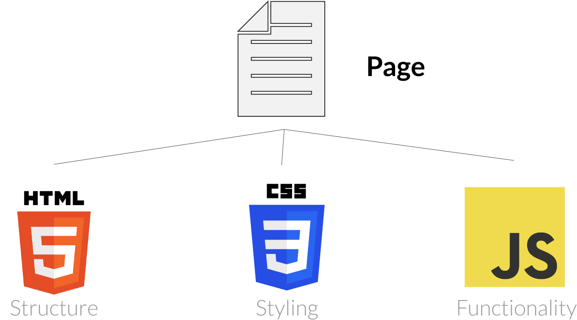
PLATFORM OF DEVELOPMENT

Slide 4
MODULES
HTML
FORMS
EXTERNAL LINKING
SELECTORS
BASIC TAGS
CSS
BORDER PROPERTIES
TEXT PEOPERTIES
MARGIN PROPERTIES
TRANSITION EFFECTS
IMAGE PROPERTIES
JAVA SCRIPT
FORM VALIDATION
FUNCTIONS
METHODS
EVENT HANDLERS
CLASSES AND OBJECTS

Slide 5
IMPLEMENTATION
HOME
Register to E-Diary
Go to Main Page
Select any one template
Add your Memories
ABOUT
Abstract of the Webpage
Developer information
Your Queries
LOGIN
Sign up with your details
Enter into Main page
CONTACT
Developer Details
Feedback

Slide 6

WEBSITE LOGO
DESIGN
YOUR
DREAMS

Slide 7

HOME PAGE

Slide 8
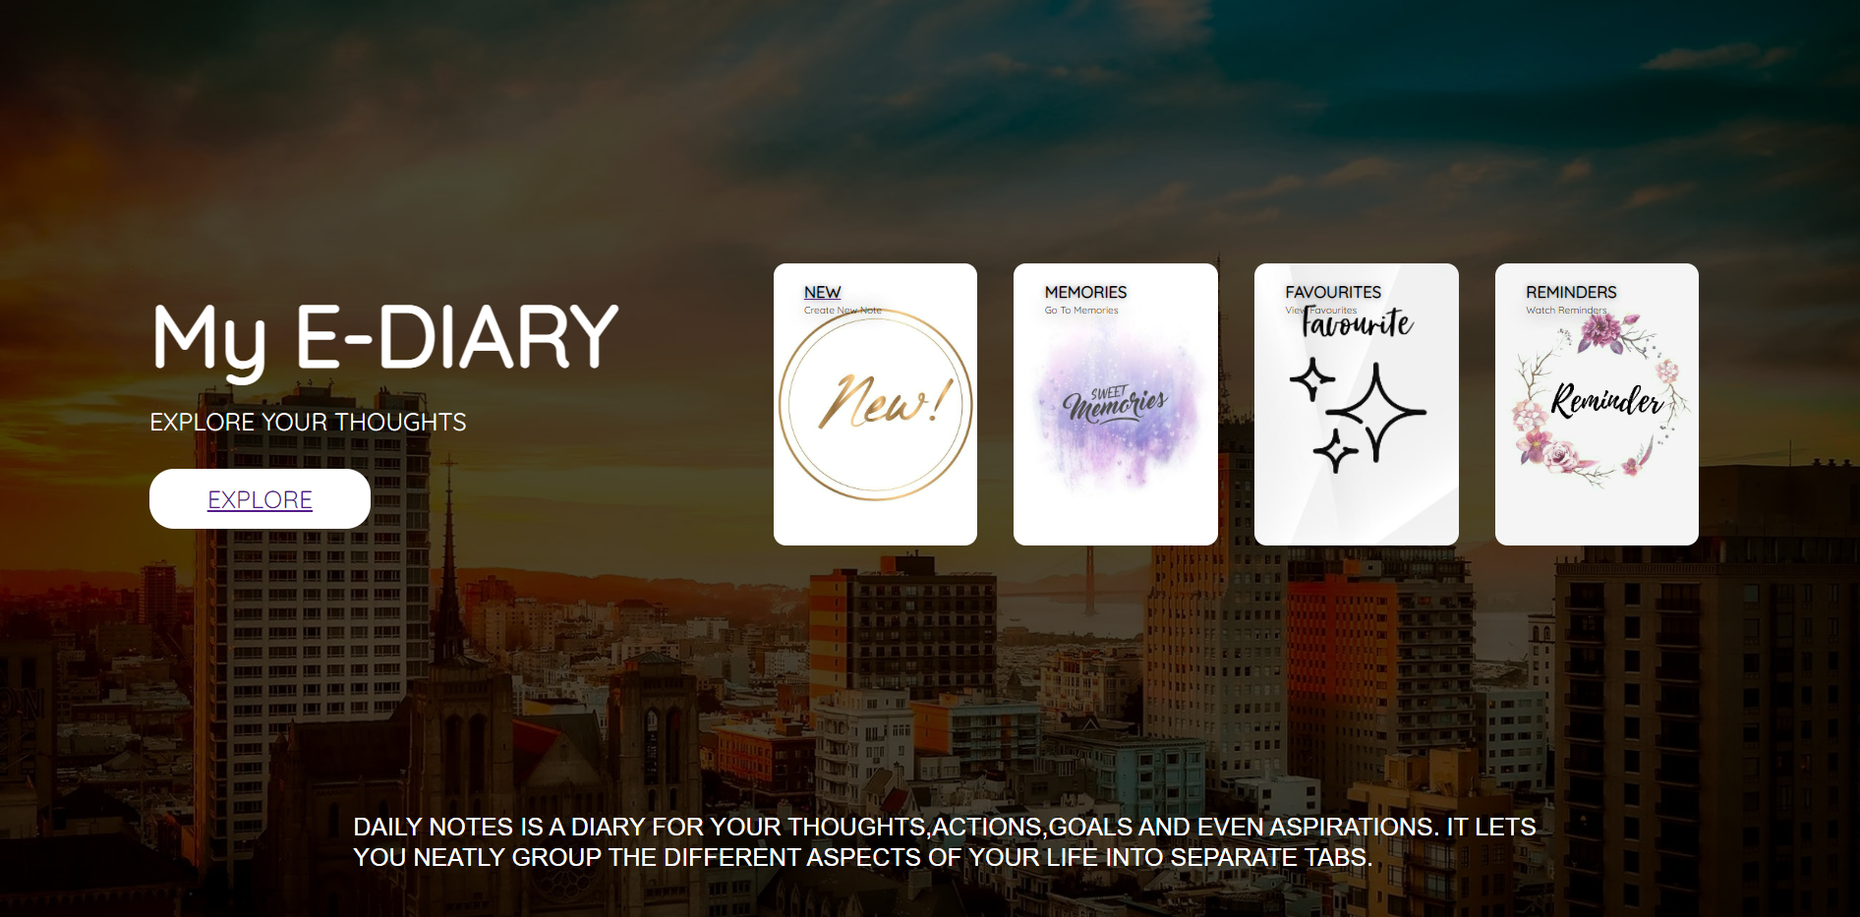
TEMPLATE PAGE

Slide 9
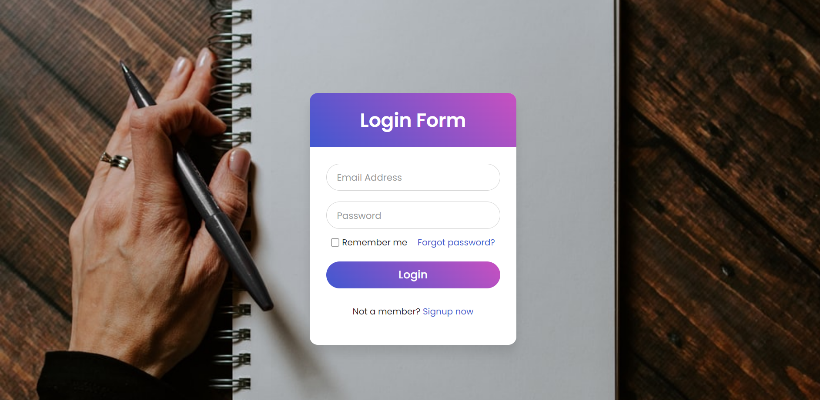
LOGIN PAGE

Slide 10

MAIN PAGE

Slide 11
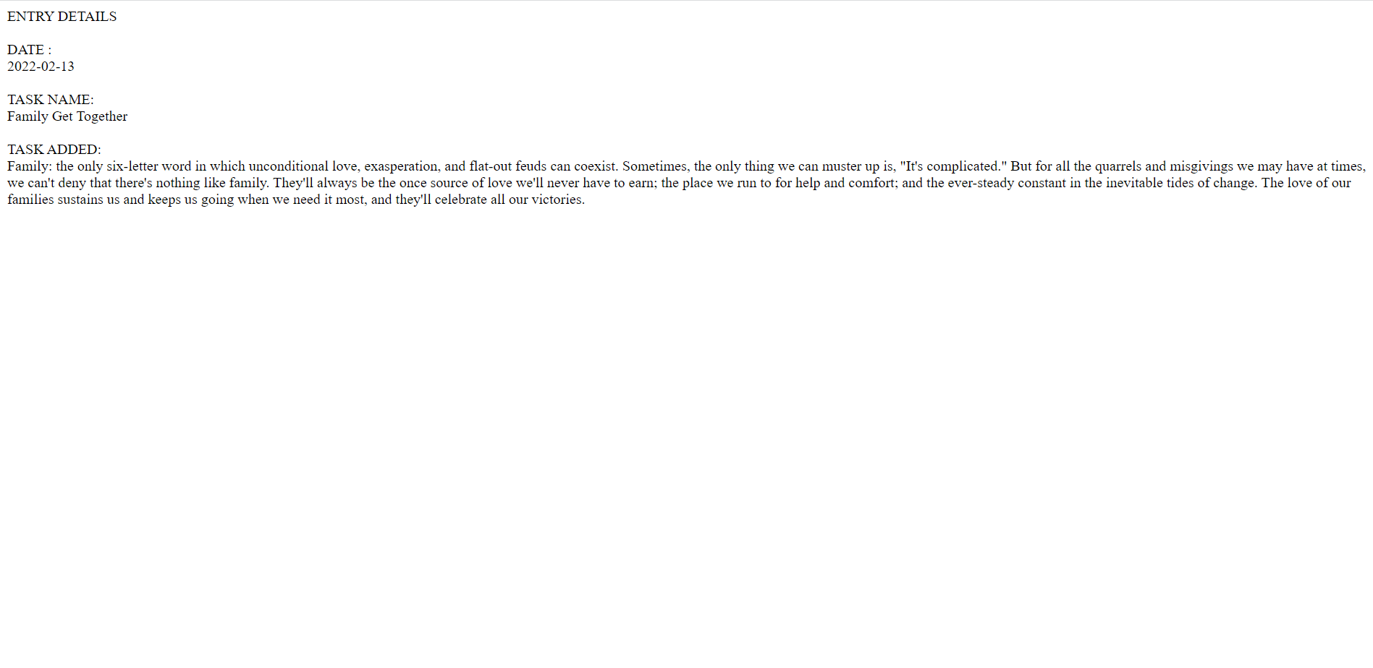
OUTPUT SCREEN

Slide 12

BY
SAMUEL ADIRALA
20761A0565

